Slide 1

Amity University, Madhya Pradesh Brain Tumor Detection Using Honey Bee
Guide: Prof. Dr. Vikas Thada
-
Lalit Kumar Upadhyay
A620145022001

Slide 2
Problem Formulation
Detect the tumor using morphological operation and honey bee algorithm with Fuzzy C-means (FCM) clustering.

Slide 3
Abstract
Traditionally, segmentation of brain MRI images is processed manually by radiologists. However, manual segmentation is high time consumption and cause unavoidable mistakes
To sort out these problems, researchers proposed various segmentation methods based on thresholding , boundary detection, region growing , and clustering.
Achieving accurate results using honey bee algorithm with FCM is the main aim of the project.

Slide 4
What is brain tumor?
A brain tumor or intracranial neoplasm occurs when abnormal cells form within the brain.
There are two main types of tumors:
Malignant tumors(Cancerous tumors)
Benign tumors.

Slide 5
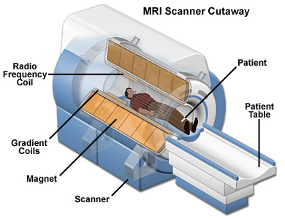
Diagnosis of brain tumors
Diagnostic tools include: patient history, a brain scan, CT scan, MRI.
MRI provides a much greater contrast between the different soft tissues of the body than computed tomography (CT)

Slide 6
MRI Brain Images
Without Tumor
With Tumor

Slide 7
Methodology followed
Pre-processing
Enhancement of the original image
Processing
Segmentation with honey bee and FCM based image clustering method
Post-processing
Extraction of brain tumour

Slide 8
Overall Flow
PRE-PROCESSING
PROCESSING
POST-PROCESING
Bilateral Filter
Clustering
Gradient
Data Collection
Adaptive Median
Artificial Bee colony Algorithm using FCM(Fuzzy-C Means)operator
Detection of Brain Tumor using Watershed
Median Filter
Gaussian filter

Slide 9
Pre-processing
In this stage, the main purpose is to eliminate noise in order to prepare it for segmentation, since noise appearing in the image might ruin segmentation quality.
Various filters such as
1. Gaussian filter
2. Median filter
3. Adaptive Median filter
4. Bilateral filter are implemented.

Slide 10
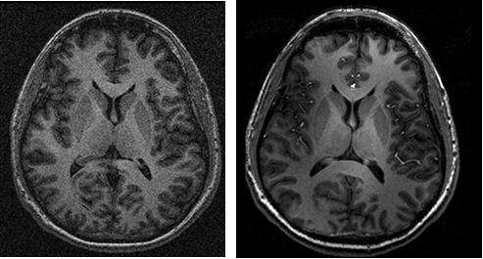
On Noise Removal

Slide 11
Gaussian filter
In image processing, a Gaussian blur is the result of blurring an image by a Gaussian function.
We need to be very careful in choosing the size of the kernel and the standard deviation of the Gaussian distribution in x and y direction should be chosen carefully.
Gaussian blurring is highly effective in removing Gaussian noise from the image.

Slide 12
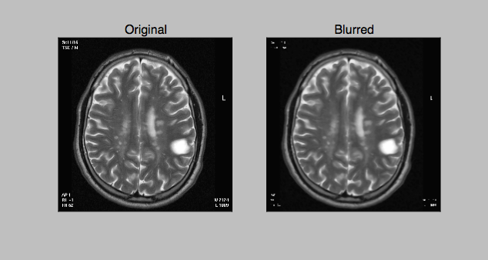
Gaussian Blur

Slide 13
Median filter
The median filter is a nonlinear digital filtering technique, often used to remove noise.
It preserves edges while removing noise
The main idea of the median filter is to run through the signal entry by entry, replacing each entry with the median of neighbouring entries

Slide 14
Median Blur

Slide 15
Adaptive Median Filter
The median is the middle value of all the pixels value in the neighbourhood.
The value of centre pixel of the window is evaluated to verify if it’s an impulse.
If it is identified as impulse, the value is replaced by the median value of the pixel in that window.

Slide 16
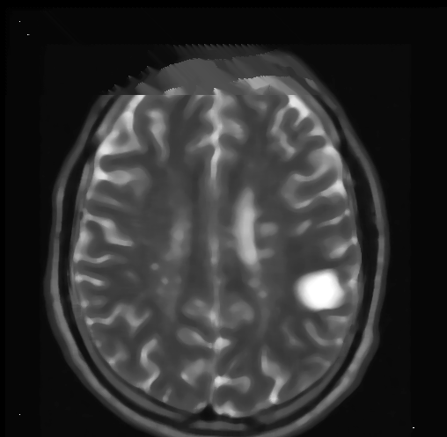
Adaptive Median Blur

Slide 17
Bilateral Filter
A bilateral filter is a non-linear, edge-preserving and noise reducing smoothing filter for images.
The intensity value at each pixel in an image is replaced by a weighted average of intensity values from nearby pixels. This weight can be based on a Gaussian distribution.
This preserves sharp edges by systematically looping through each pixel and adjusting weights to the adjacent pixels accordingly.

Slide 18
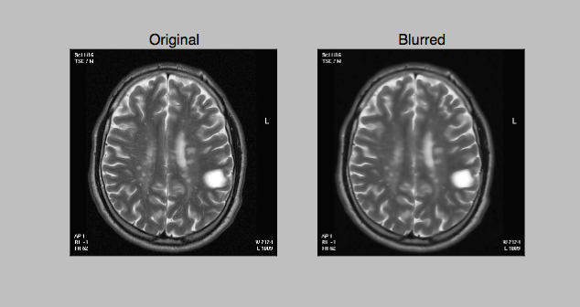
Bilateral Filter

Slide 19
Comparison of PSNR and RMSE for noise in MRI
Filters | PSNR | RMSE
Gaussian Filter | 16.8259 | 1.3505e+003
Median | 9.5131+2.7288i | -1.1391
Adaptive Median | 17.0226+4.0931i | 1.3400e+003
Bilateral | 18.5085 | 1.3505e+003

Slide 20
Processing
The segmentation of an image involves the division or separation of the image into regions of similar attribute.
The ultimate aim in a large number of image processing applications is to extract important features from the image data.
Here FCM and Artificial Bee Algorithms are used respectively.

Slide 21
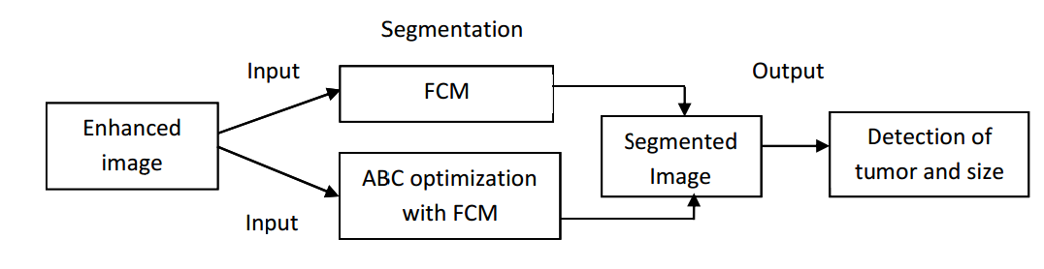
Processing

Slide 22
Fuzzy C-means Clustering | K-Means Clustering
1. In fuzzy clustering, each point has a probability of belonging to each cluster. | 1. Each point completely belongs to just one cluster in the traditional k-means.
2. Fuzzy k-means specifically tries to deal with the problem where points are somewhat in between centers or otherwise ambiguous by replacing distance with probability. | 2. Fuzzy k-means uses a weighted centroid based on those probabilities.
3. The resulting clusters are best analyzed as probabilistic distributions . | 3. The resulting clusters are best analyzed as a hard assignment of labels.
4. With regards to performance, the FCM therefore needs to perform k (i.e. number of clusters) multiplications for each point, for each dimension hence it is slow. (full inverse-distance weighting). | 4. K means has to perform only k multiplications , hence is faster (distance calculation).

Slide 23
Applications of K-means
Clustering algorithm can be used to monitor the students' academic performance. Based on the students' score they are grouped into different k-means clustering, in particular when using heuristics such as Lloyd's algorithm, is rather easy to implement and apply even on large data sets.
As such, it has been successfully used in various topics, including market segmentation, computer vision, geostatistics, astronomy and agriculture. It often is used as a preprocessing step for other algorithms, for example to find a starting configuration

Slide 24
Applications of FCM
Clustering problems have applications in biology, medicine, psychology, economics, and many other disciplines.
In the field of bioinformatics, clustering is used as a pattern recognition technique to analyze gene expression data from microarrays or other technology.
Fuzzy c-means has been a very important tool for image processing in clustering objects in an image.
In marketing, customers can be grouped into fuzzy clusters based on their needs, brand choices, psycho-graphic profiles, or other marketing related partitions.

Slide 25
Why FCM
Among the numerous algorithms proposed for brain MR image segmentation, the popular one is Fuzzy C-means (FCM) algorithm.
FCM is an unsupervised clustering algorithm that outperforms the other clustering algorithms in terms of computational complexity and accuracy of segmentation.

Slide 26
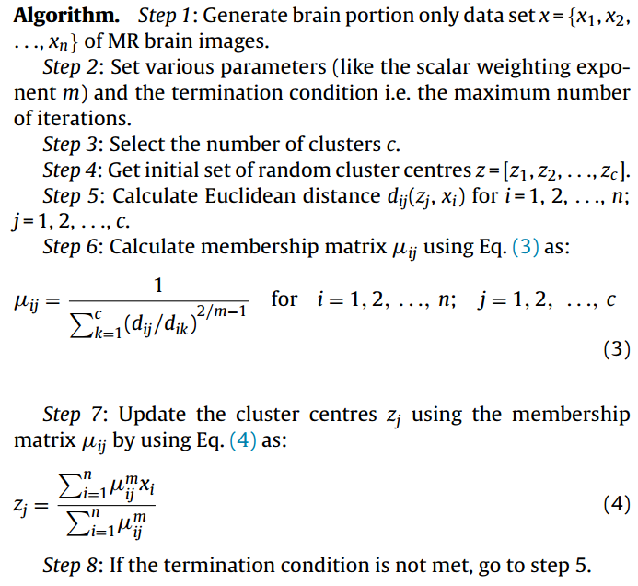
FCM Algorithm

Slide 27
Why Bee Algorithm?
MR images always contain a significant amount of noise caused by operator, equipment, and the environment.
This leads to serious inaccuracies in the segmentation as any changes in pixels intensity such as noise, significantly affect the clustering results. One way to improve accuracy of the results is to use optimization method.
Optimization is a technique used to seek values for a set of parameters that maximize or minimize objective functions subject to certain constraints. Artificial Bee Colony algorithm is a novel optimization algorithm inspired by the natural behaviour of honey bees in their search process for the best food sources.

Slide 28
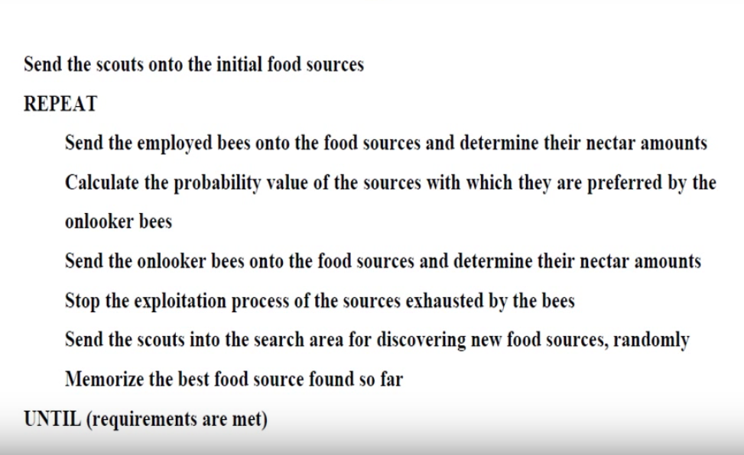
ABC ALGORITHM

Slide 29
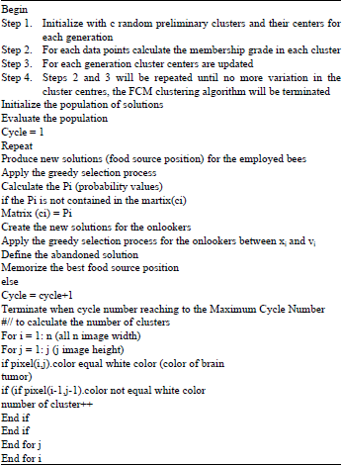
ABC along with FCM

Slide 30
Result After FCM

Slide 31
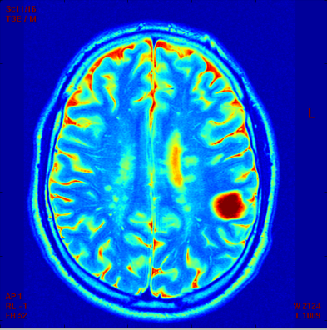
Result After ABC

Slide 32
Post-Processing
After segmentation, tumor extraction process is carried out. Firstly, segmented image is filtered if it includes a great amount of noise.
Gray level thresholding is employed to convert that image to the binary image.
Watershed of the image is retrieved to extract the tumor from the segmented image.

Slide 33
Watershed Algorithm
The term watershed refers to a ridge that divides areas drained by different river systems. A catchment basin is the geographical area draining into a river or reservoir.

Slide 34
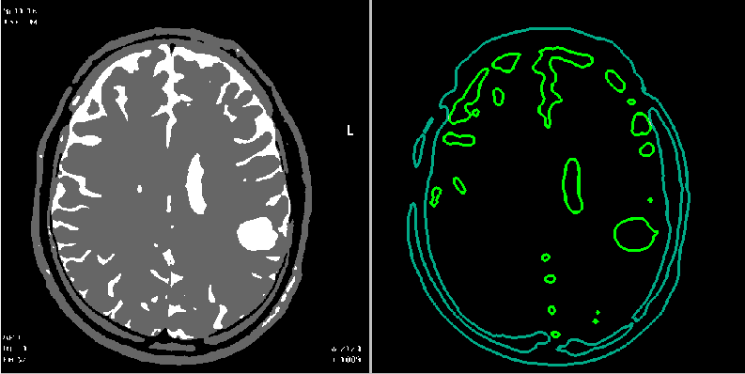
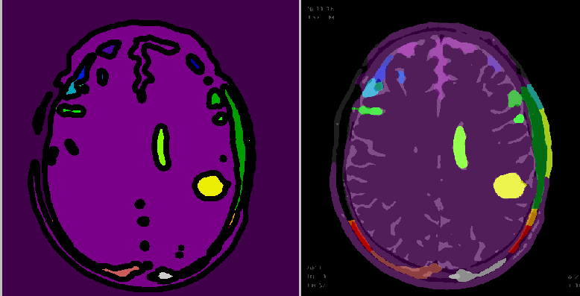

Slide 35
Conclusion
In pre-processing, Gaussian, Median, Adaptive Median and Bilateral filters were analyzed and compared. Both visual and numerical results indicate that Bilateral filter outperforms the others.
Initially, the enhanced MRI image was run on FCM. The output of which was run on ABC. The visual results showed that the combination of the two algorithms gave better results.

Slide 36
Dataset Source
http://www.oasis-brains.org/app/action/BundleAction/bundle/OAS1_CROSS
http://www.medinfo.cs.ucy.ac.cy/index.php/downloads/datasets

Slide 37
References
[1] Karaboga D. An Idea Based On Honey Bee Swarm For Numerical Optimization, Technical Report-TR06, Erciyes university, Engineering Faculty, Computer Engineering Department, 2005.
[2] Dervis Karaboga and Celal Ozturk,”Fuzzy Clustering with Artificial Bee Colony Algorithm”, Scientific Research and Essays, Vol 5.
[3] T. Logeswari and M. Karnan, An improved implementation of brain tumor detection using segmentation based on soft computing, International Journal of Computer Theory and Engineering, Vol. 2, No. 4, August, 2010.
[4] E. Bonabeau, M. Dorigo, G. Theraulaz, “Swarm intelligence: From Natural to Artificial Systems” New York, NY:Oxford University Press, 1999

Slide 38
References
[5] Emrah Hancer, Celal Ozturk and Dervis Karaboga “Extraction of brain tumor from MRI images with artificial bee colony segmentation methodology” Department of Computer Engineering, Erciyes University, Turkey.
[6] Bahriye, A. and D. Karaboga, 2012. A modified artificial bee colony algorithm for real-Parameter optimization. Int. J. Inform. Sci., 192: 120-142. DOI: 10.1016/j.ins.2010.07.015
[7] http://docs.opencv.org/2.4/modules/imgproc/doc/filtering.html
[8] http://docs.opencv.org/3.1.0/d3/db4/tutorial_py_watershed.html
[9] Anam Mustaqeem ,Ali Javed, Tehseen Fatima, An Efficient Brain Tumor Detection Algorithm Using Watershed & Thresholding Based Segmentation, I.J. Image, Graphics and Signal Processing, 2012, 10, 34-39 Published Online September 2012 in MECS

Slide 39
Thank you

